Slide 1
Graph Searching
Depth-first and Breath-first search

Slide 2
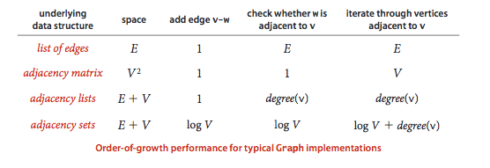
Run times

Slide 3
Terminology
A cycle is a path that is simple except that the first and last vertex are the same.
A graph is connected if there is a path from every node to every other node in the graph.
A graph which is not connected is composed of connected components.

Slide 4
Depth-first search
Depth-first search is a natural way to visit each node in a graph.
Is a graph connected?
What are the connected components in a graph?
Does a graph contain a path between vertices u and v?
Does a graph contain a cycle?

Slide 5

Graph traversal

Slide 6
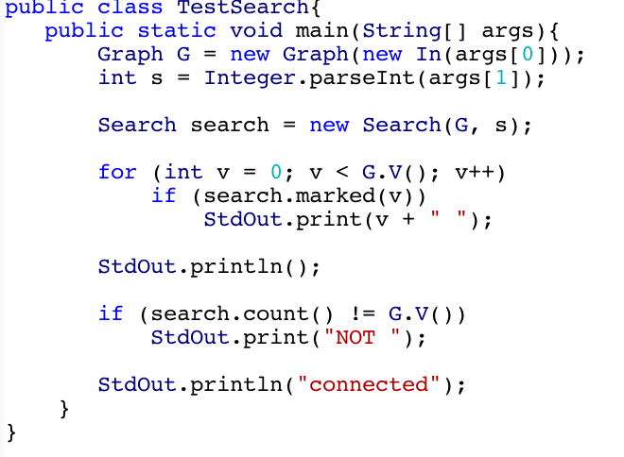
Graph traversal client

Slide 7
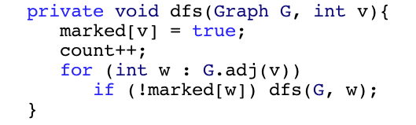
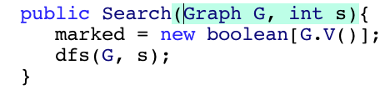
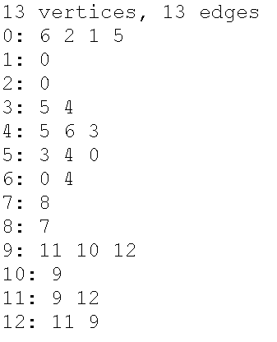
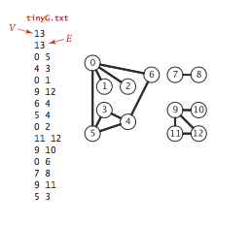
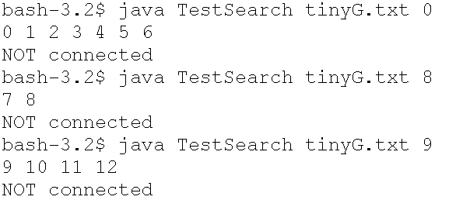
Searching
Priming call
Depth-first search (DFS)

Slide 8




Searching for a connected component
Call sequence
dfs(0) finds 0, 6, 4, 5, 3, 2, 1
dfs(8) finds 8, 7
dfs(9) finds 9, 11, 12, 10

Slide 9
DFS: adjacency list
This algorithm has to assign a value to each entry in the marked[ ] array (|V| entries). In doing this, each edge in E is encountered twice (undirected graph). Therefore, there are |V| + 2*|E| steps or O(|V| + |E|).

Slide 10

Searching
Depth-first search (DFS)
Adjacency matrix
dfs(0) finds 0, 1, 2, 5, 3, 4, 6
dfs(8) finds 8, 7
dfs(9) finds 9, 10, 11, 12
0 1 2 3 4 5 6 7 8 9 10 11 12

Slide 11
DFS: adjacency matrix
The algorithm visits every entry in the adjacency matrix a[ ][ ] which has |V| rows and |V| columns. Therefore |V|² is the amount of work done or O(|V|²).

Slide 12
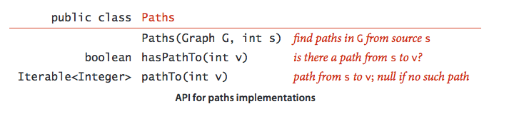
Finding paths

Slide 13
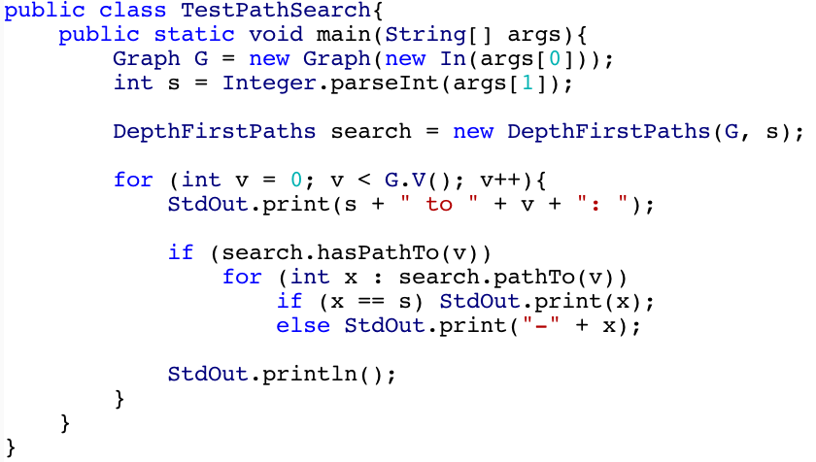
Path finding client

Slide 14
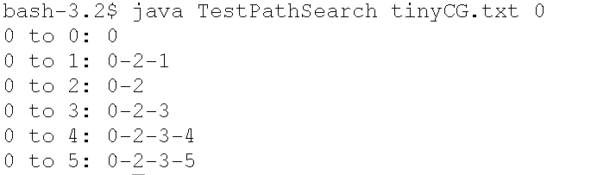
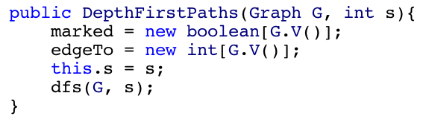
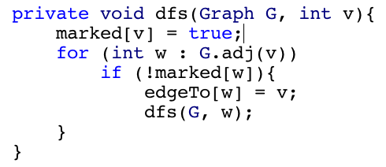
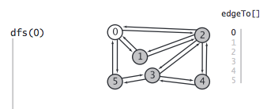
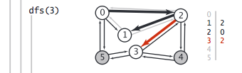
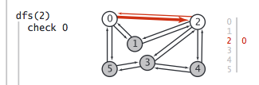
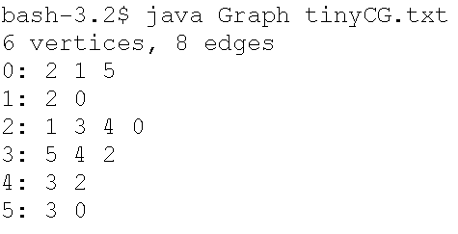
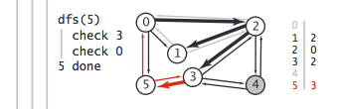
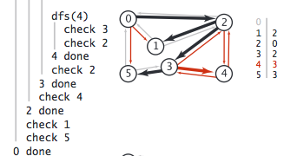
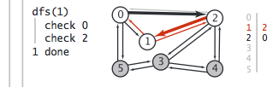
Path finding
Priming call
Depth-first search (DFS)

Slide 15



Breadth-first search
Breadth-first search is a natural way to visit each node in a graph. Start at vertex v. Visit all the nodes that are 1 “step” away from v, then visit all the nodes 2 “steps” away from v, …
Find the shortest path from v to any other vertex in G?

Slide 16
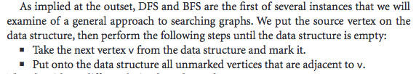
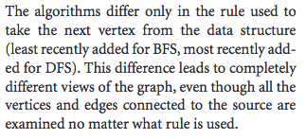
Traversing

Slide 17
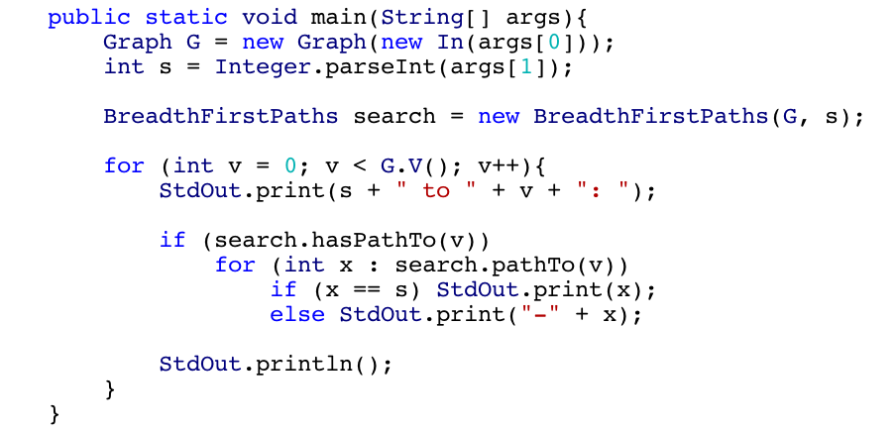
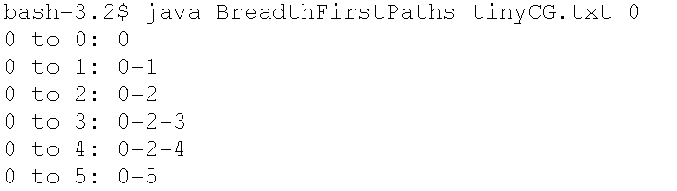
Path finding client

Slide 18
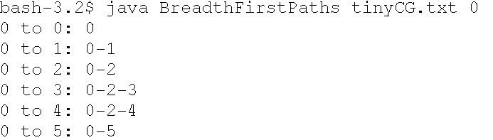
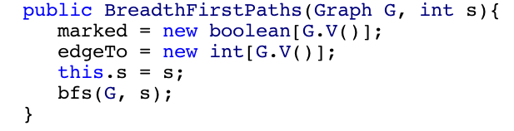
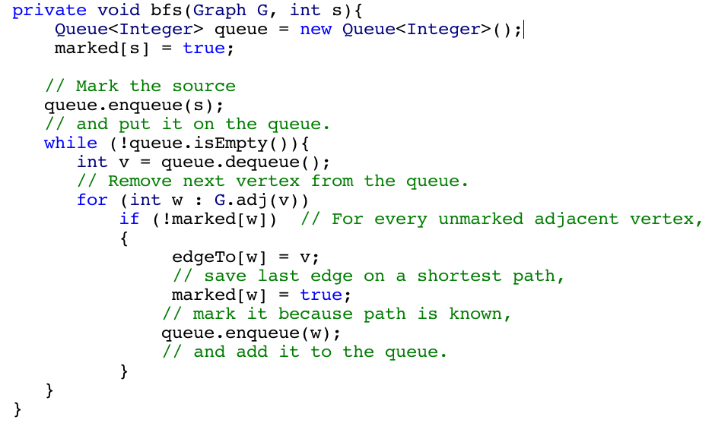
Shortest Path finding
Priming call
Breadth-first search (BFS)

Slide 19



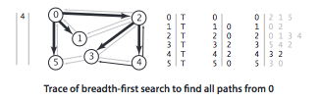

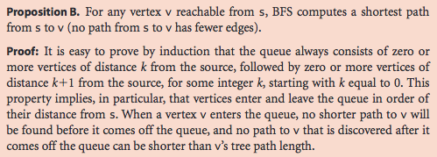


Slide 20
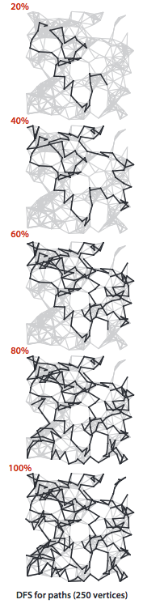
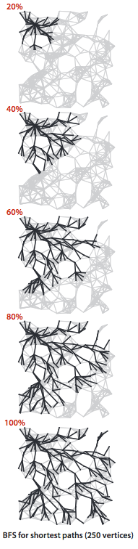
Side-by-side comparison

Slide 21
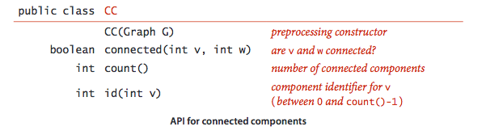
Connected components

Slide 22
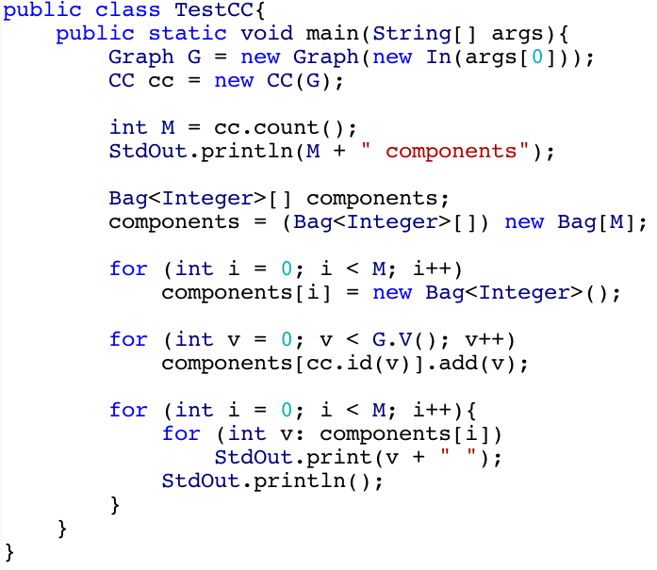
Connected components client

Slide 23
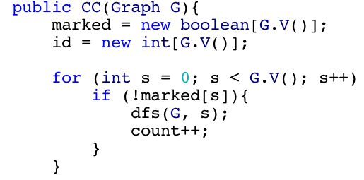
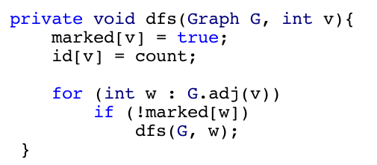
Connected components
Priming call
Depth-first search (DFS)

Slide 24
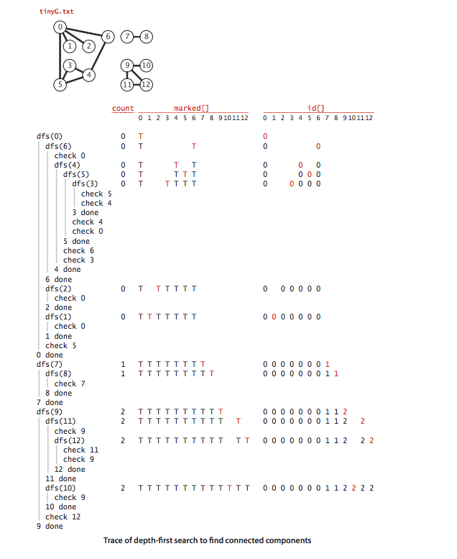

Slide 25
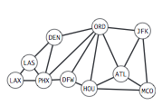
Symbol graphs
Most graphs seen in applications have a name associated with each vertex
A special delimiter separates adjacent vertices to allow spaces in a name
The number of vertices and edges are implicitly defined

Slide 26
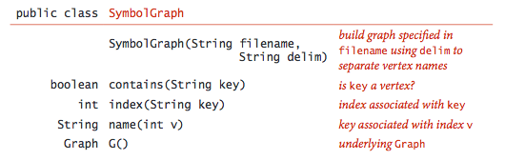
API

Slide 27

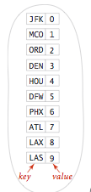

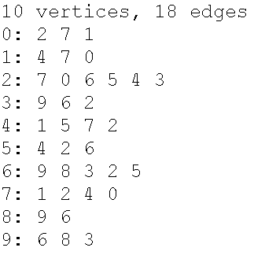
Example
Inverted table
Symbol table
Graph

Slide 28
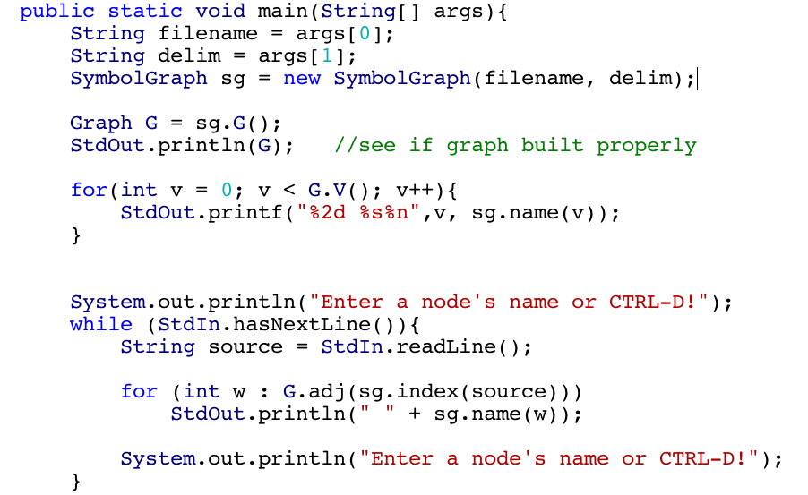
Test client

Slide 29
Cycle detection
DFS
Union Find

Slide 30
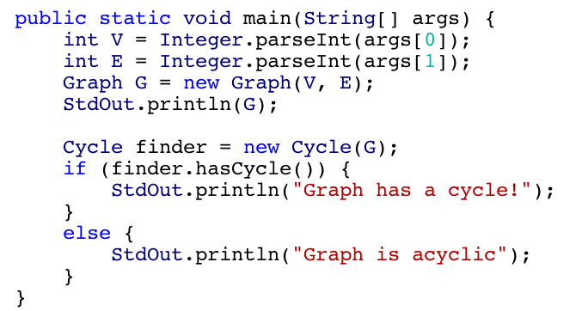
Cycle detecting client

Slide 31

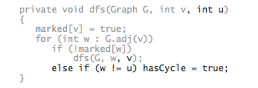
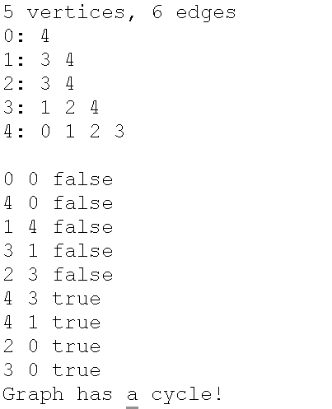
Cycle detection
Priming call
Depth-first search (DFS)
0
2
4
1
3
Cycle!

